Slide 1
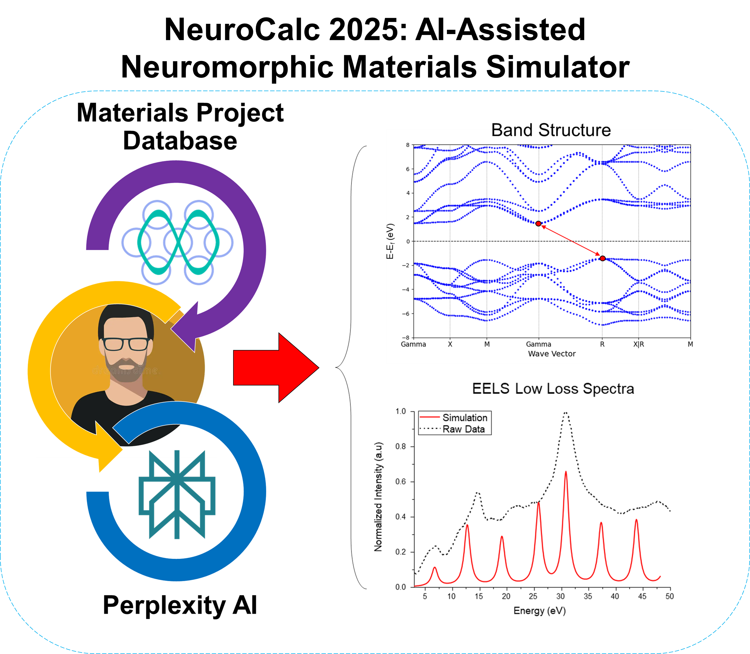

Slide 2
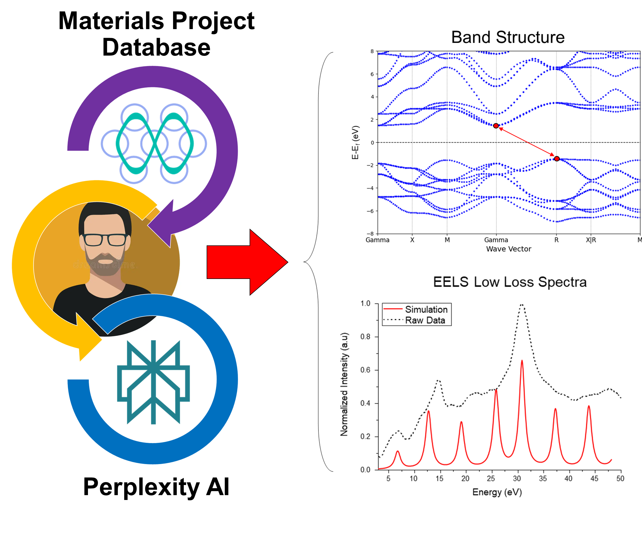
NeuroCalc 2025: AI-Assisted Neuromorphic Materials Simulator

Slide 3

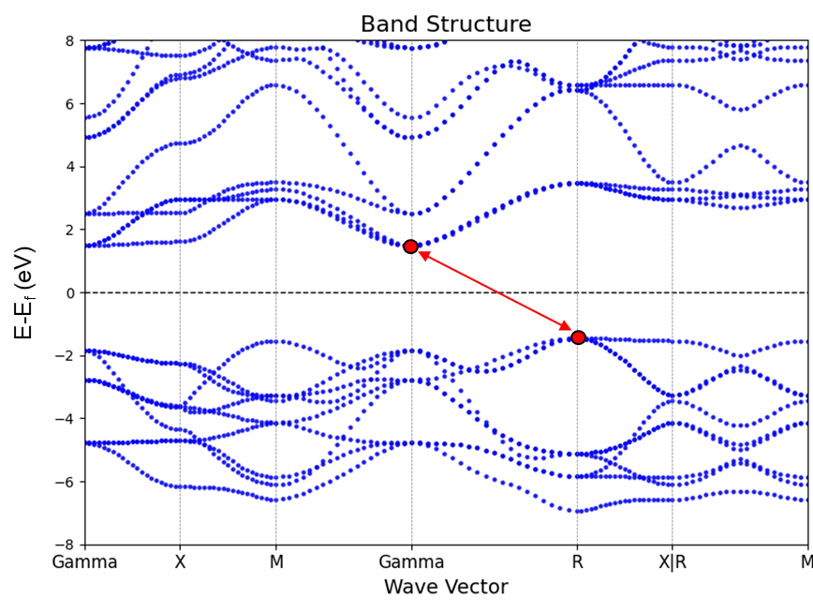
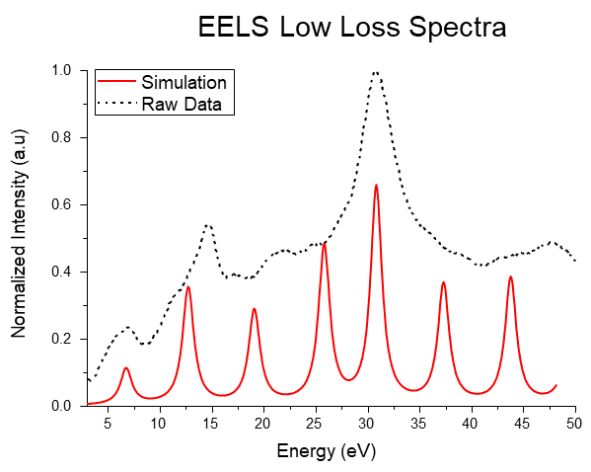
NeuroCalc 2025: AI assisted Neuromorphic Materials Simulator:
Example Case SrTiO3 (Cubic)
Materials Project Database
Human User
Band Structure
Perplexity AI

Slide 4
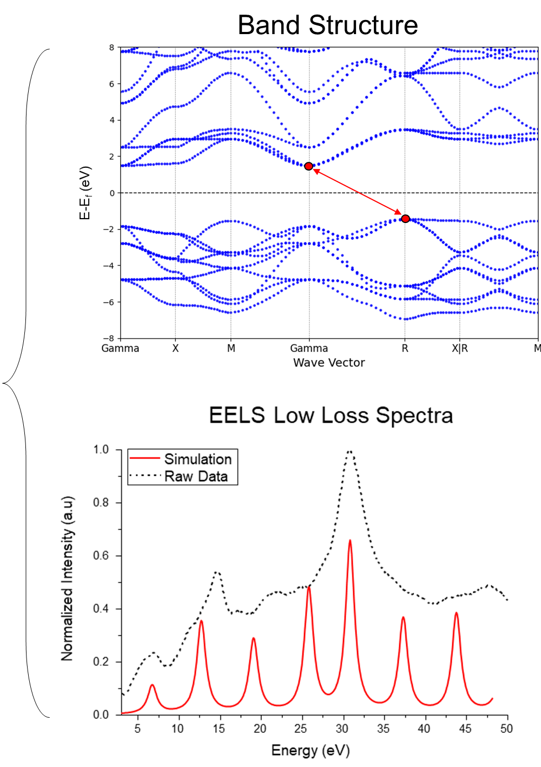


NeuroCalc 2025: AI assisted Neuromorphic Materials Simulator:
Example Case SrTiO3 (Cubic)
Materials Project Database
Perplexity AI

Slide 5
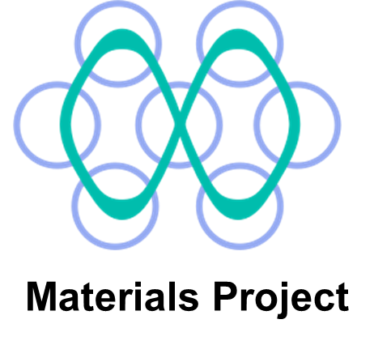


Materials Project Database
NeuroCalc 2025: AI assisted Neuromorphic Materials Simulator:
Example Case SrTiO3 (Cubic)
Band Structure
Perplexity AI

Slide 6
Materials Project Database
NeuroCalc 2025: AI assisted Neuromorphic Materials Simulator:
Example Case SrTiO3 (Cubic)
Band Structure
Perplexity AI

Slide 7
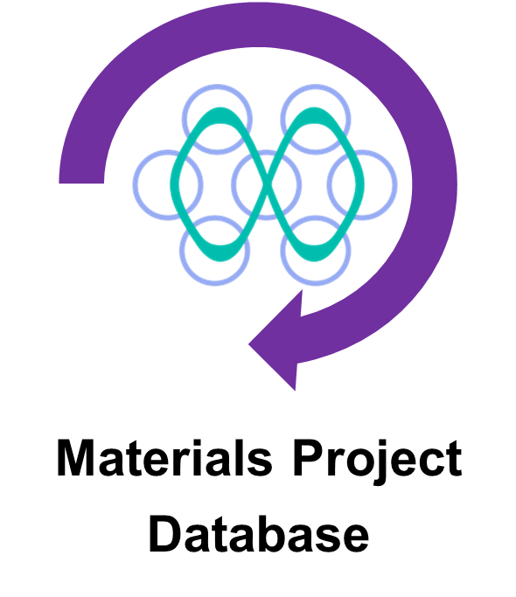

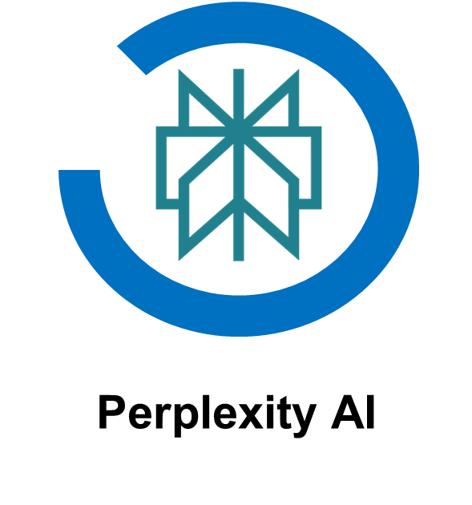
Current Work
Developing an AI assisted Neuromorphic Material Simulator
How does it work:
Current Work
Developing an AI assisted Neuromorphic Material Simulator
Materials Project
Database
Human User
Perplexity AI
How does it work?
API
API

Slide 8
NeuroCalc 2025: AI assisted Neuromorphic Materials Simulator:
Example Case SrTiO3 (Cubic)

Slide 9




NeuroCalc 2025: AI assisted Neuromorphic Materials Simulator:
Example Case SrTiO3 (Cubic)
Band Structure
Materials Project
Perplexity AI

Slide 10
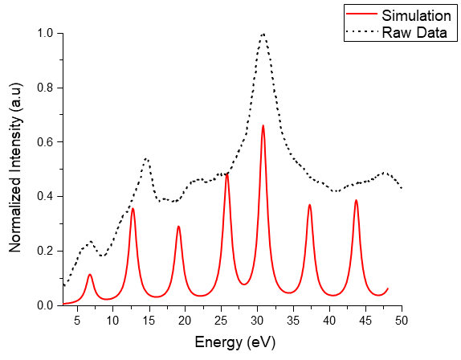
Neuromorphic Calculator 2025:
Developing an AI assisted Neuromorphic Material Simulator:
Example Case SrTiO3 (Cubic)

Slide 11
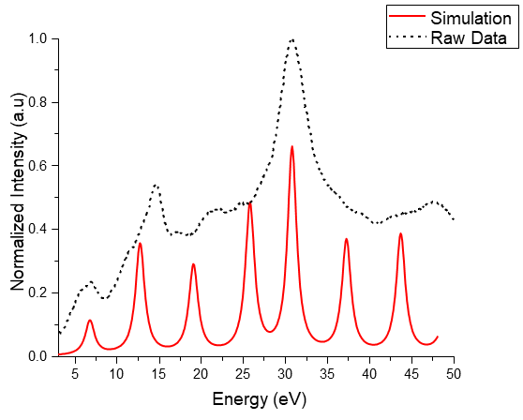
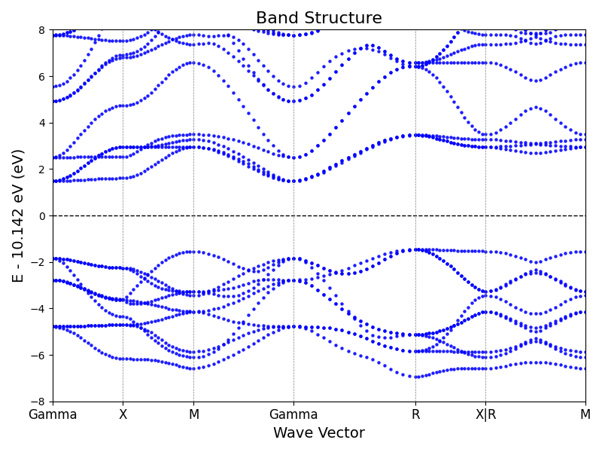
Neuromorphic Calculator 2025:
Developing an AI assisted Neuromorphic Material Simulator:
Example Case SrTiO3 (Cubic)
E-E_{f} (eV)

Slide 12
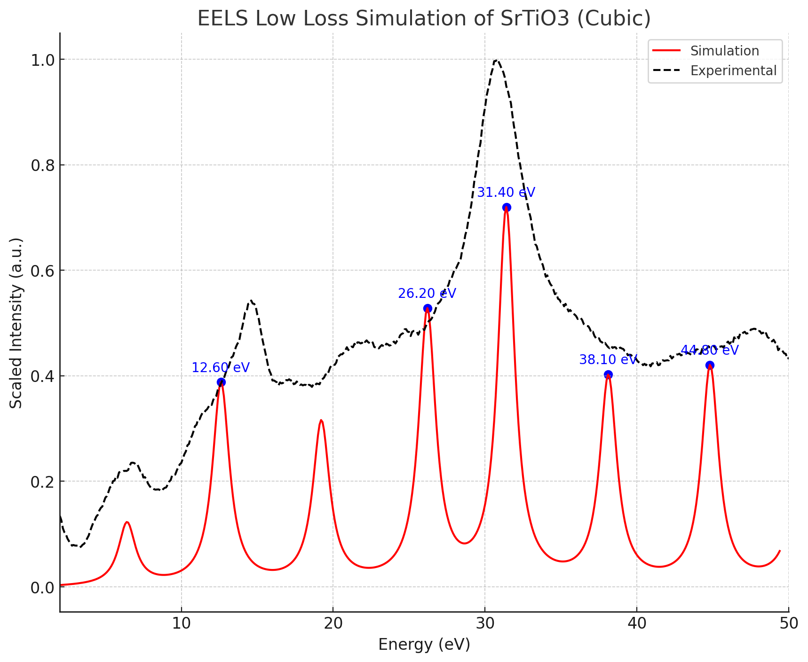
Neuromorphic Calculator 2025: Example Case SrTiO3 (Cubic)

Slide 13
EELS Low Loss Spectra
1.0
Simulation
0.8
Raw Data
0.6
Normalized Intensity (a.u)
0.4
0.2
0.0
5
10
15
20
25
30
35
40
45
50
Energy (eV)

